Slide 1
Abstract
Handwritten patterns, which are a part of the so-called noninvasive procedures, are widely accepted to convey important and sensitive information regarding common and secure transactions However, they're liable to imitating procedures which are well-known under the criminologist term forgeries. Among several sorts of handwriting, the signature has been found to be the foremost prone to fraud. this can be because of the very fact that humans can easily recall their signatures so as to accomplish their everyday transactions like documents and checks. The most reason why persons can use their signature with increased confidence stems from the actual fact that continuous and iterative training is allotted by writing the identical and stuck handwritten symbols. this can be an a-priori assumption for the signature verification system, when it's employed to verify the claimed identity. It should provide a comparatively fast, economical and assured to identify the individuals against potential breach efforts.

Slide 2
Introduction
Identification is an important process to recognize and distinguish one thing with others; it can be animals, plants, and humans. This identification can be done by recognizing the human natural characteristic, known as biometrics. The characteristics are physiological and behavioral characteristics. The first characteristic is relatively stable and consists of fingerprints, hand silhouette, distinctive facial, iris pattern, or the eye retina. On the other hand, signature, speech patterns, or typing rhythm are the example of the behavioral characteristic. The signature is widely used as an identification system against a person. It can be defined as an image of the visual representation of an object. Furthermore, the image is a visual representation of an object after suffering various transformations of data from various forms of numerical sequence.

Slide 3
Methodology
Database Preparation
Pre-Processing
Feature Extraction
Verification using extracted Features

Slide 4
Data set description
Two folders of datasets: There are Two folders in the dataset folder. One comprises of signatures of the actual person and the other folder consists of forgery of the original signature of the actual person. These dataset images consisting are the signatures of the individual members in the project group and the forgery is attempted by other persons in the same group. All the images taken are original colour images. Some images are also taken from online sources to test the same.

Slide 5
For the program to execute we require a square image with high resolution and which is noise free.
Signature should be made on an uncrumbled blank sheet of paper and shot with a camera which is focused on the image.
The image should then be modified to a square resolution to be used.
Because of privacy issues we have not used our actual signatures as our dataset.
Thus we have used names with various strokes as the signature and labelled them accordingly as genuine or forgery.

Slide 6
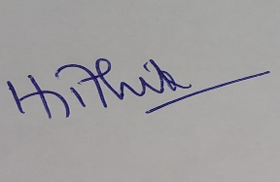
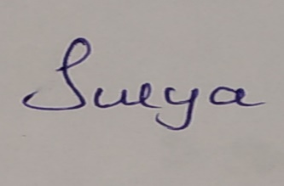
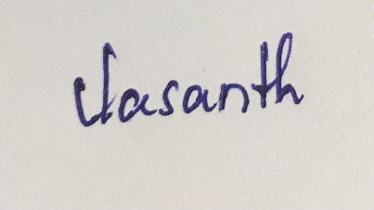
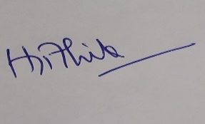
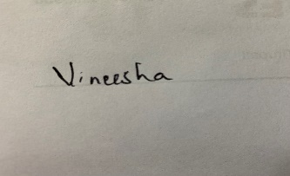
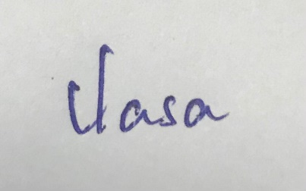
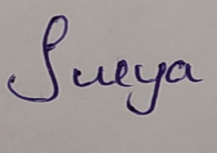
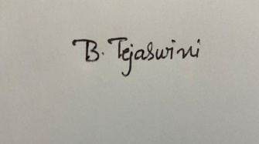
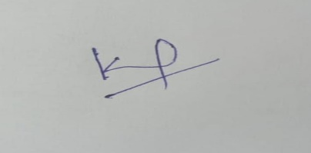
Genuine Signatures:

Slide 7
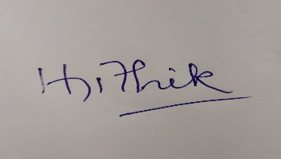
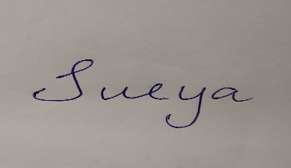
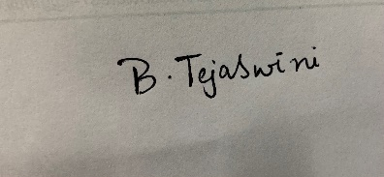
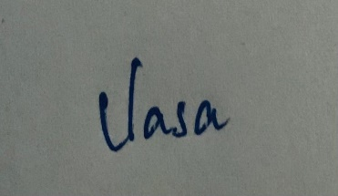
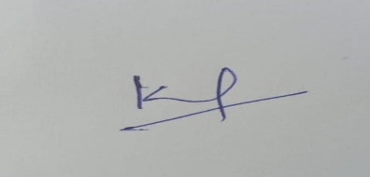
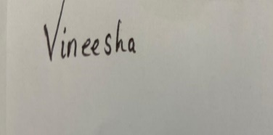
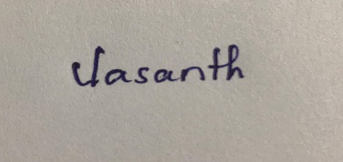
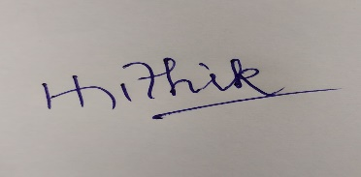
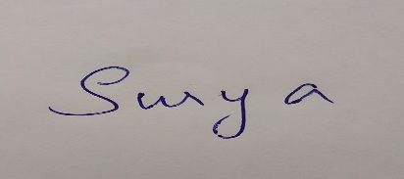
Forged Signatures:

Slide 8
Pre-Processing
The Steps of Pre-Processing of the image from database of dataset are :
1. Cropping
2. Filtering
3. Conversion of Color Image to Gray scale
4. Binarization of Grey scale image
5. Thinning
6. Rotation for Skew Correction
7. Resizing

Slide 9
Feature Extraction
The following features are extracted from the processed image:
Normalized Signature Area:
Total number of black signature pixels divided by total number of pixels of the image
Aspect Ratio:
The Aspect ratio of the processed image = width/height
Maximum Horizontal Projection:
It is the maximum number of black pixels among all horizontal rows of the image.

Slide 10
Feature Extraction
The following features are extracted from the processed image:
End Points:
It is the number of endpoints of the signature
Centroid of vertically divided images:
It is the pair of centroid of the 2 images formed by vertically dividing the main image
Skew Angle:
It is the angle made by the centroids of the vertically divided images

Slide 11
Verification using Extracted Features
Once the Features are extracted they are stored in a Vector. Now we need to fix minimum error threshold values for each feature implemented using which it classifies genuine signatures.
Conventionally finding the error threshold values should be done by using an Machine Learning Algorithm that will minimize the error threshold.
But since we have not been taught Machine Learning, we have done this step manually by generating the tables of data for input and selecting error threshold values. The more images this step is applied to the more accurate our algorithm becomes.

Slide 12
Literature Review:
S.No | Title | Authors | Algorithms
1 | A New Online Signature Verification by SpatioTemporal Neural Netwrok | Maryam Moghadam Fard, Mehdi Moghadam Fard, Nasser Mozayani | Spatio-Temporal Neural Netwrok
2 | Signature recognition using probabilistic neural network | Heri Nurdiyanto,Hermanto | probabilistic neural network
3 | Fusion Of Static Image And Dynamic Information For Signature Verification | F. Alonso-Fernandez, J. Fierrez, M. Martinez-Diaz, J. OrtegaGarcia | Fusion Of Static Image And Dynamic Information
4 | Human-Assisted Signature Recognition based on Comparative Attributes | Aythami Morales, Julian Fierrez, Ruben Vera-Rodriguez, Derlin Morocho | Comparative Attributes

Slide 13
Literature Review:
5 | Offline Handwritten Signature Recognition Using Adaptive Variance Reduction | Ruangroj Sa-Ardship and Kuntpong Woraratpanya | Adaptive Variance Reduction, histogram of gradient (HOG) and pyramid histogram of gradient (PHOG) techniques
6 | On the Evaluation of Human Ratings for Signature Recognition | Derlin Morocho 1,2, Javier Hernandez-Ortega2 , Aythami Morales2 , Julian Fierrez2 , Javier Ortega-Garcia2 | Automatic Signature verifier(ASV)
7 | Offline Signature Recognition System using Histogram of Oriented Gradients | Ms. Pallavi Patil, Mr. Bryan Aleida, Ms. Niketa Chettiar, Mr. Joyal Babu | Histogram of oriented gradients(HOG)

Slide 14
Implementation:
function [Feat_Val,im_processed] = featureExtraction(I)
I2=imresize(I,[512 ,512]);
I3=rgb2gray(I2);
I3=im2double(I3);
I3=im2bw(I3);
I3 = bwmorph(~I3, 'thin', inf);
I3=~I3;
im1 = I3;
k=1;
for i=1:512
for j=1:512
if(I3(i,j)==0)
u(k)=i;
v(k)=j;
k=k+1;
I3(i,j)=1;
end
end
End
C=[u;v];
N=k-1;
oub=sum(C(1,:))/N;
ovb=sum(C(2,:))/N;
for i=1:N
u(i)=u(i)-oub+1;
v(i)=v(i)-ovb+1;
end
C=[u;v];
ub=sum(C(1,:))/N;
vb=sum(C(2,:))/N;
ubSq=sum((C(1,:)-ub).^2)/N;
vbSq=sum((C(2,:)-vb).^2)/N;
for i=1:N
uv(i)=u(i)*v(i);
end
uvb=sum(uv)/N;
M=[ubSq uvb;uvb vbSq];
minIgen=min(abs(eig(M)));
MI=[ubSq-minIgen uvb;uvb vbSq-minIgen];
theta=(atan((-MI(1))/MI(2))*180)/pi;
thetaRad=(theta*pi)/180;
rotMat=[cos(thetaRad) -sin(thetaRad);sin(thetaRad) cos(thetaRad)];
for i=1:N
v(i)=(C(2,i)*cos(thetaRad))-(C(1,i)*sin(thetaRad));
u(i)=(C(2,i)*sin(thetaRad))+(C(1,i)*cos(thetaRad));
end
C=[u;v];
for i=1:N
u(i)=round(u(i)+oub-1);
v(i)=round(v(i)+ovb-1);
end
mx=0;my=0;
if (min(u)<0)
mx=-min(u);
for i=1:N
u(i)=u(i)+mx+1;
end
end
if (min(v)<0)
my=-min(v);
for i=1:N
v(i)=v(i)+my+1;
end
end
C=[u;v];
for i=1:N
I3((u(i)),(v(i)))=0;
end

Slide 15
xstart=512;
xend=1;
ystart=512;
yend=1;
for r=1:512
for c=1:512
if((I3(r,c)==0))
if (r<ystart)
ystart=r;
end
if((r>yend))
yend=r;
end
if (c<xstart)
xstart=c;
end
if (c>xend)
xend=c;
end
end
end
end
for i=ystart:yend
for j=xstart:xend
im((i-ystart+1),(j-xstart+1))=I3(i,j);
end
end
im_processed = im;
PixelB = 0;
PixelA = 0;
for i=ystart:yend
for j=xstart:xend
if (im(i-ystart+1,j-xstart+1)== 0)
PixelB = PixelB + 1;
end
PixelA = PixelA + 1;
end
end
NSA = PixelB/PixelA;
height_sign = yend-ystart;
length_sign = xend-xstart;
aspect_ratio = length_sign/height_sign;
max=0;
for i=ystart:yend
summ=0;
for j=xstart:xend
if(im((i-ystart+1),(j-xstart+1))==0)
summ=summ+1;
end
end
if (summ>max)
max=summ;
end
end
max;
max1=0;
for i=xstart:xend
summ=0;
for j=ystart:yend
if(im((j-ystart+1),(i-xstart+1))==0)
summ=summ+1;
end
end
if (summ>max1)
max1=summ;
end
end
max1;
xdiff=xend-xstart;

Slide 16
ydiff=yend-ystart;
Hor_Proj = max/xdiff;
Ver_Proj = max1/ydiff; i1 = im1;
[row, col, depth] = size(i1);
addrow = ones(1, col);
i1 = [addrow; addrow; i1; addrow];
[row, col, depth] = size(i1);
addcol = ones(row, 1);
i1 = horzcat(addcol, i1, addcol, addcol);
[row, col, depth] = size(i1);
i1=~i1;
crosspoints=0;
for r = 3:row-1
for c = 2:col-2
if(i1(r,c)==1)
if (i1(r-1,c-1)+i1(r-1,c)+i1(r-1,c+1)+i1(r,c-1)+i1(r,c+1)+i1(r+1,c-1)+i1(r+1,c)+i1(r+1,c+1)==1)
crosspoints=crosspoints+1;
end end end end
n1 = im(:, 1: xdiff/2);
n2 = im(:, xdiff/2+1:xdiff);
sum1=0;
pix_total=0;
for i=1:ydiff
pix_sum=0;
for j=1:xdiff/2
if(n1(i,j)==0)
pix_sum=pix_sum+1;
pix_total=pix_total+1;
end end
sum1=sum1+(pix_sum*i);
end
Y1=sum1/pix_total;
RY1=Y1/ydiff;
sum1=0;
for i=1:xdiff/2
pix_sum=0;
for j=1:ydiff
if(n1(j,i)==0)
pix_sum=pix_sum+1;
end end
sum1=sum1+(pix_sum*i);
end
X1=sum1/pix_total;
RX1=2*X1/xdiff;
sum1=0;
pix_total=0;
for i=1:ydiff
pix_sum=0;
for j=1:xdiff/2
if(n2(i,j)==0)
pix_sum=pix_sum+1;
pix_total=pix_total+1;
end end
sum1=sum1+(pix_sum*i);
end
Y2=sum1/pix_total;
RY2=Y2/ydiff;
sum1=0;
for i=1:xdiff/2
pix_sum=0;
for j=1:ydiff
if(n2(j,i)==0)
pix_sum=pix_sum+1;
end end
sum1=sum1+(pix_sum*i);
end
X2=sum1/pix_total;
RX2=2*X2/xdiff;
centroid = [ [RX1 RY1] [RX2 RY2] ];
m=xdiff;
m=m/2;
k=m+X2;
slope=(Y2-Y1)/(k-X1);
Feat_Val = [ NSA aspect_ratio Hor_Proj crosspoints centroid slope];
end

Slide 17
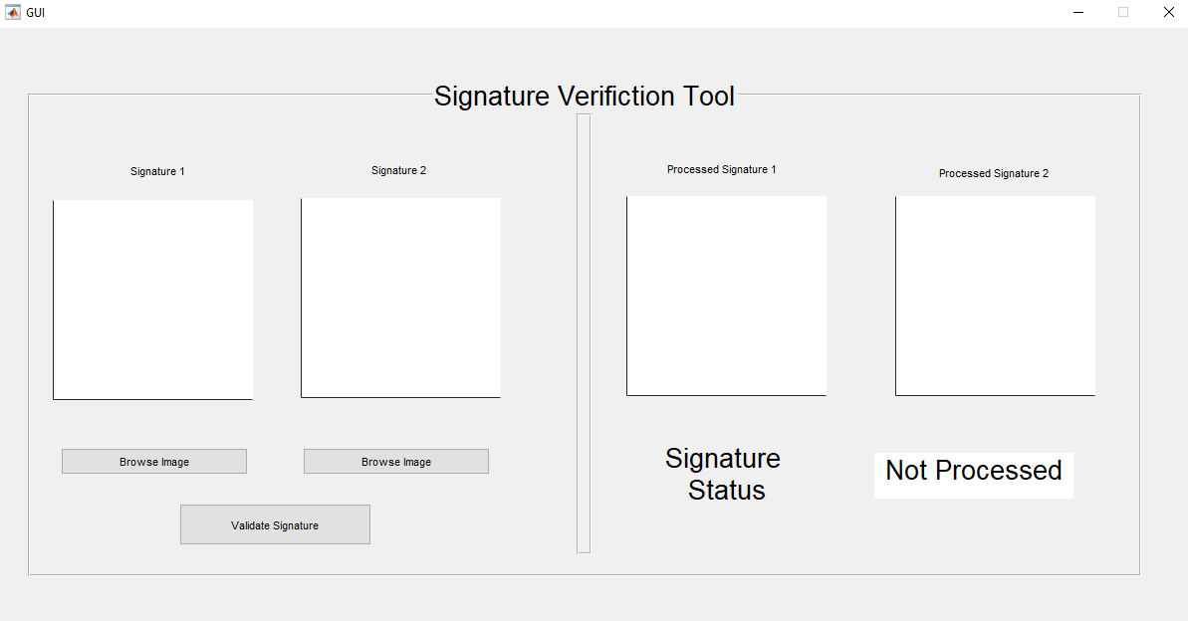
Verification Tool:

Slide 18
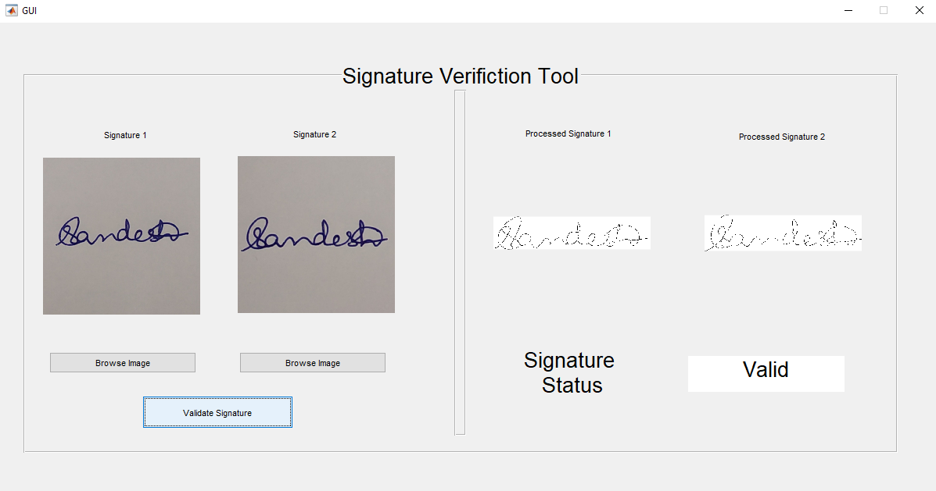
Outputs:
Figure1: Verification and Validation of both Genuine signatures with identifiable stroke difference

Slide 19
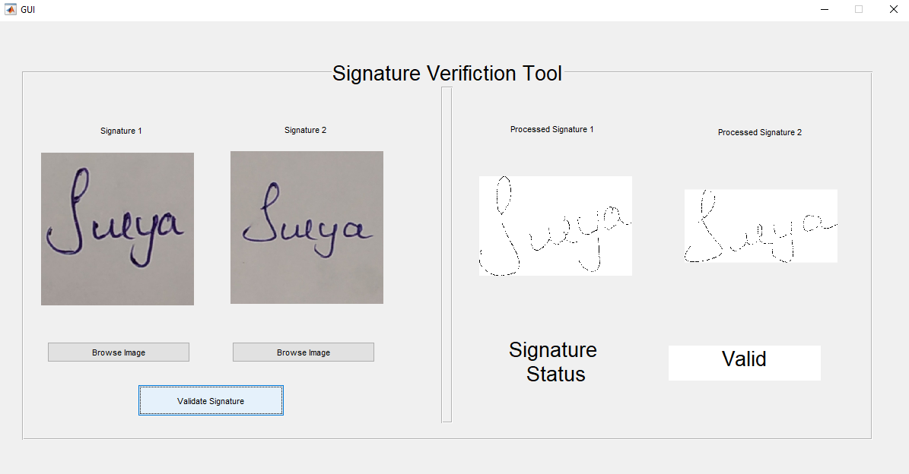
Figure2: Verification and Validation of both Genuine signatures with very similar strokes

Slide 20
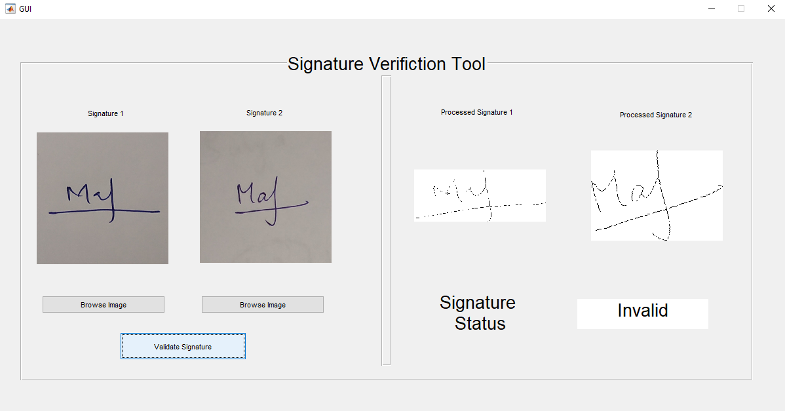
Figure3: Verification and Validation of Genuine signature and Forgery signature

Slide 21
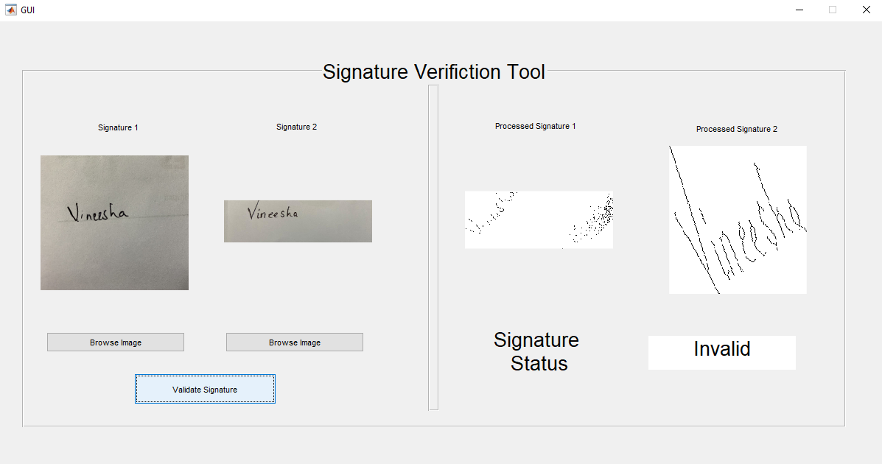
Figure4: Verification and Validation of Genuine signature and Forgery signature with various dimensions

Slide 22
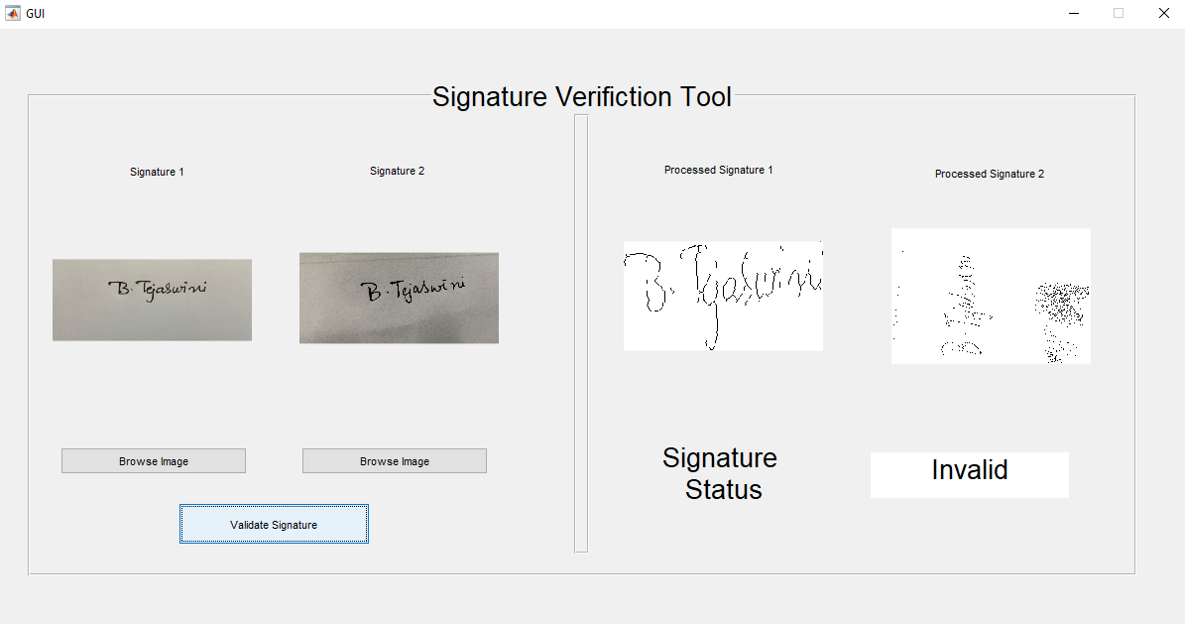
Figure5: Verification and Validation of both Genuine signature and with different texture, image quality
( A failed test case )

Slide 23
Results
We have written a program in MATLAB that identified and distinguishes between genuine and forged signatures with an accuracy of 94.5 obtained by testing with a pair of 20 samples.

Slide 24
Future Work:
Train the model to get more accuracy when signature is made with various pens with different stroke, Various lighting conditions, Different camera angles and rotations, Accuracy detection when genuine signatures of same person are to be compared.

Slide 25
Scope for Improvement
The program we have written is very primitive compared to what should be implemented for live security systems and can be improved by:
Making a machine learning neural network and training it to generate more accurate error threshold values that can improve the accuracy of the program.
Increasing the database we can have more data to train our algorithm which will also increase the accuracy of our program.

Slide 26
Scope for Improvement
Back propagation learning :
Algorithm is one of the most important developments in neural networks
This learning algorithm is applied to multilayer feed-forward networks consisting of processing elements with continuous differentiable activation functions
The networks using the back propagation learning algorithm are also called back propagation networks (BPN)
Given a set of input, output pairs this algorithm provides a procedure for changing the weights in a BPN
The basic concept used for weight updation is the gradient-descent method as used in simple perceptron network

Slide 27
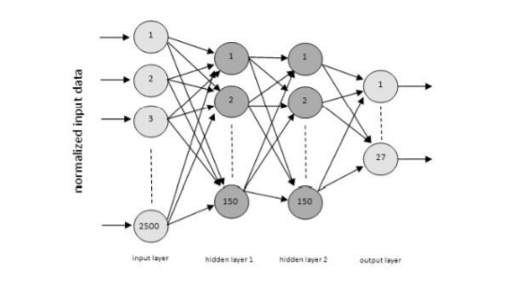
Back propagation Neural Network Structure:

Slide 28
Conclusion
The proposed project Behavioral Signature Biometrics is programmed in Matlab which distinguishes signatures of genuine and forgery of a person with a high accuracy using image processing techniques.
Though the distinction is accurate, it certainly has some drawbacks such as it fails at a certain point when image orientation and sizes are comparably different.
Pointing out future trends and challenges in biometric research, special emphasis is given to signature biometrics in the field of e-health and e-security.

Slide 29
References
http://ieeexplore.ieee.org.egateway.vit.ac.in/stamp/stamp.jsp?tp=&arnumber=4565065&tag=1
http://ijain.org/index.php/IJAIN/article/view/53/ijain_v2i1_p46_53
http://ieeexplore.ieee.org.egateway.vit.ac.in/stamp/stamp.jsp?tp=&arnumber=5414157
http://ieeexplore.ieee.org.egateway.vit.ac.in/stamp/stamp.jsp?tp=&arnumber=8270325
http://ieeexplore.ieee.org.egateway.vit.ac.in/stamp/stamp.jsp?tp=&arnumber=7408952
http://ieeexplore.ieee.org.egateway.vit.ac.in/stamp/stamp.jsp?tp=&arnumber=7815681
http://ieeexplore.ieee.org.egateway.vit.ac.in/document/83187668

